Slide 1
Introduction to Software Engineering
Software Process Model
Muhammad Nasir
m.nasir@iiu.edu.pk

Slide 2
Unified Process (UP) Model
During the early 1990s James Rumbaugh, Grady Booch, and Ivar Jacobson began working on a “Unified Method” that would combine the best features of each of their individual object-oriented analysis and design methods
And adopted additional features proposed by other experts in object-oriented modeling.
The result was UML—a Unified Modeling Language that contains a robust notation for the modeling and development of object-oriented systems.
UML became a de facto industry standard for object-oriented software development
Notes:
[deː ˈfaktoː]) is a Latin expression that means "concerning fact." In law, it often means "in practice but not necessarily ordained by law" or "in practice or actuality, but not officially established.”

Slide 3
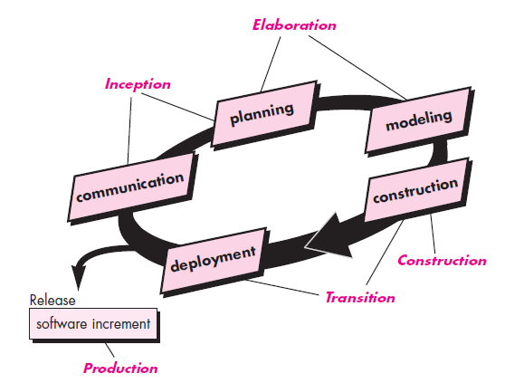
Phases of the Unified Process

Slide 4
Inception Phase
Unified Process is also no exception and has the same five Process Framework activities
Inception Phase encompasses both customer communication and planning activities
Notes:
Inception: The beginning of something, such as an undertaking; a commencement.

Slide 5
Inception Phase
Architecture at this point is nothing more than a tentative outline of major subsystems and the function and features that populate them
Planning identifies resources, assesses major risks, defines a schedule

Slide 6
Elaboration Phase
Elaboration phase encompasses the Planning and modeling activities of the generic process model.
Elaboration refines and expands the preliminary use cases that were developed as part of the inception phase
Notes:
In software and systems engineering, a use case is a list of steps, typically defining interactions between a role (known in UML as an "actor") and a system, to achieve a goal. The actor can be a human or an external system.

Slide 7
Elaboration Phase
And expands the architectural representation to include Five different views of the software
Requirements Model
Use Case Model
Design Model
Implementation Model
Deployment Model

Slide 8
Construction Phase
The Construction Phase of the UP is identical to the construction activity defined for the generic software process.

Slide 9
Transition Phase
The Transition Phase of the UP encompasses the latter stages of the generic construction activity and the first part of the generic deployment (delivery and feedback) activity.
Software is given to end users for beta testing and user feedback reports both defects and necessary changes.

Slide 10
Production Phase
The production phase of the UP coincides with the deployment activity of the generic process.
During this phase, the ongoing use of the software is monitored, support for the operating environment (infrastructure) is provided,
And defect reports and requests for changes are submitted and evaluated.

Slide 11
The End
Thanks for listening
Questions would be appreciated.

